Slide 1



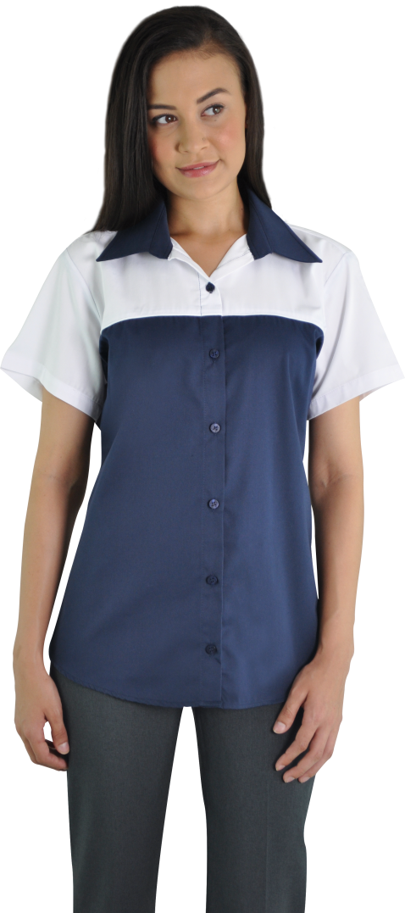


MECHANICAL & GARAGE UNIFORMS

